Slide 1
Eaglesoft Modernization Proposal discussion
September 2026

Slide 2
Our Understanding

Slide 3
Status | Tyler / Ri
 | Not Started​ | WIP​ | Complete​ | QA’d​
 | ​Notes
 | ​
 | ​
OUR UNDERSTANDING
Patterson is seeking to modernize Eaglesoft by creating a reusable data and API layer, upgrading selected PowerBuilder and UI workflows, and building automated performance testing to ensure the product remains reliable
What We Heard
    Eaglesoft is a desktop dental practice management platform built mainly on PowerBuilder
    PowerBuilder code still accesses SQL Anywhere directly through embedded SQL, DataWindows, dynamic SQL, and transaction logic
    Rules are distributed across the UI, application code, database queries and stored procedures, making change and testing difficult
    A working PostgreSQL environment already exists, so the primary need is architectural decoupling and modernization
    The platform needs a reusable service and API foundation that supports current desktop modernization while preserving options for future browser or SaaS development
Desired Outcomes
    Establish a reusable service and data layer that modernizes the UI and implements a 3-tier architecture to decouple UI logic from direct data access without destabilizing the current product
    Initiate an incremental modernization of priority workflows and selected UI experiences
    Build automated full-stack performance testing, telemetry, and release gates to validate performance across the desktop, APIs, services, database, and infrastructure
    Develop a maintainable platform with a path toward future browser or cloud capabilities

Slide 4
Key considerations driving the approach…
A technical modernization approach that keeps

Slide 5
Eaglesoft Architecture – What We Know & Understand Today
Our Understanding
MATURITY LEGEND
ABOVE PAR
AT
PAR
BELOW PAR/GAP
Status | Drew / Jim
 | Not Started​ | WIP​ | Complete​ | QA’d​
 | ​Notes
 | ​
 | ​
1
Designed as a traditional client-server architecture, the application and database reside on a central server, typically located at a dental office, and interact with end-user desktops (clients). While this model works well for single-office setups, it struggles to support larger dental groups with more than 30 users
Frontend UI is built on C++ and PowerBuilder, technologies that are outdated and less commonly used in modern software development making resources in the market difficult to find to maintain and update
Backend business logic is written in C++, but modernization efforts have introduced .NET 4.6, with plans to upgrade to .NET 4.8 in version 24.20. but many areas of the application still rely on outdated 32-bit libraries (eg. LeadTools, TXTextControl, and CodeJock) posing challenges in transitioning to modern 64-bit systems
Application database is SQL Anywhere, a lightweight and self-contained database engine; however, support for this database is ending in January 2025, prompting an extensive migration to a new database
Business logic is embedded in the data layer, comprising the majority of the application's functionality across 1,500 stored procedures. This design limits scalability and makes the system unsuitable as the foundation for a web-based, multi-tenant application capable of supporting thousands of customers
Fast Check-In
(.NET )
Eaglesoft API
Dental Office
2
Server
App Layer
Patterson App Server
(.NET C#)
External Interfaces
Generic Imaging Devices (Twain)
Digital Radiography Devices (Direct)
DICOM File
PACS
3
Clinical
(PowerBuilder)
Client (PowerBuilder)
DB Upgrade
(.NET C#)
Server Status
(.NET C#)
Data Layer
4
Eaglesoft DB (SQL Anywhere)
5

Slide 6
PowerBuilder Data Access & UI Modernization Approach

Slide 7
West Monroe recommends 2 goals for this modernization effort: aligning Eaglesoft to a classic 3-tier architecture and modernizing the user interface stack
OUR PERSPECTIVE
Status | Ri
 | Not Started​ | WIP​ | Complete​ | QA’d​
 | ​Notes
 | ​
 | ​
VISION FOR THE FUTURE
CURRENT STATE
PowerBuilder supports a practice-local application where the user experience, business behavior, and data access have grown together.
The user experience remains tied to a legacy desktop runtime.
Business rules and transaction behavior span UI code and direct data paths.
Device and partner dependencies shape each journey transition.
Screen-only replacement preserves the existing business and data coupling.
West Monroe recommends taking a user-journey focused approach to the modernization program. But identifying and prioritizing user journeys, we can align the modernization and testing strategy approach to ensure that changes are desirable, performant and validated.
An independent application foundation
POWERBUILDER RETIREMENT
PowerBuilder has become a niche, legacy application stack. West Monroe recommends modernizing to a web-based user interface layer to ensure Pattern can continue to hire skilled engineers, to support a potential SaaS-ification of the product, and alignment with potential desktop and mobile deployment capabilities.
THREE-TIER RESPONSIBILITY
Modern application architecture practices over the last 15 years recommend a 3-tier structure: data access, service/domain, and user interface to ensure each layer can be maintained and upgraded separately. West Monroe recommends aligning to this high-level approach as an outcome of the modernization.
WEB EXPERIENCE ON PREMISES
React provides browser or PWA delivery within the practice network. Embedded and desktop routes remain transition choices. WAN network support could potentially allow multi-site expansion for practices with that network capability.
JOURNEY-LED DELIVERY
By using a journey-led approach, the disruption inside individual critical user journeys is minimized. Piloting specific personas or roles holistically can create a more seamless transition experience for customers. In addition, end to end testing for specific flows can be aligned with the testing workstream.
Outcome
An independent user experience, reusable business operations, governed data access, and a clear path to PowerBuilder retirement.

Slide 8
Recommended target architecture for Eaglesoft user journeys
TARGET ARCHITECTURE
Status | Ri
 | Not Started​ | WIP​ | Complete​ | QA’d​
 | ​Notes
 | ​
 | ​
A user journey is the end-to-end work a staff member or customer completes to achieve an outcome. Modernize complete journeys through a three-tier architecture that separates the user interface, API and domain services, and data access.
PRACTICE NETWORK
1 USER INTERFACE LAYER
PowerBuilder during transition
Only for user journeys that have not moved
Modern Eaglesoft application
Complete journey moves
React and TypeScript
Complete staff and customer journeys
CORE RECOMMENDATION
Identify end-to-end user journeys for PowerBuilder retirement. After a journey meets acceptance criteria, retire its screen and runtime, rebuild its UI logic in React, and route business rules and data access through the API and data access layers.
2 API LAYER
Domain services
Business rules, authorization, and transaction control
Shared engineering controls
3 DATA ACCESS LAYER
Centralized, governed PostgreSQL interaction
Automated testing, performance evidence, telemetry, and release controls
ON-PREMISES DATA AND INTEGRATIONS
PostgreSQL, documents, imaging, and approved practice integrations
Initial phase: define journey boundaries and validate PostgreSQL readiness, practice server capacity, device and integration dependencies, and deployment support before selecting the first journey.
Notes:
Architecture shown is a proposal recommendation. All deployment remains on premises. Confirm application boundaries, PostgreSQL readiness, practice server capacity, device integration, and deployment support during the initial phase.
Patterson public Eaglesoft product information: https://www.pattersondental.com/cp/software/dental-practice-management-software/eaglesoft-
Internal RFP understanding: /Users/rscott/Documents/clients/private equity/patient square capital/patterson companies/Deliverables/2026-09-23 UTC - Patterson Eaglesoft Our Understanding.md
Internal technical narrative: /Users/rscott/Documents/clients/private equity/patient square capital/patterson companies/Working/2026-09-23 UTC - Patterson Eaglesoft Technical Narrative Revision 2.md
Historical diligence, validation context only: /Users/rscott/Documents/clients/private equity/patient square capital/patterson companies/Context/2026-09-23 UTC - Patterson Eaglesoft Prior Deliverables Evidence Store.md

Slide 9
Recommended target architecture for Eaglesoft user journeys
TARGET ARCHITECTURE
Status | Ri
 | Not Started​ | WIP​ | Complete​ | QA’d​
 | ​Alternative version of Slide 8
 | ​
 | ​
USER INTERFACE LAYER
React + TypeScript
CORE RECOMMENDATION
Retire PowerBuilder journey by journey
Identify end-to-end user journeys and define acceptance criteria
Retire each screen and runtime only after its journey is accepted
Rebuild UI logic in React + TypeScript
Route business rules through API and domain services
Centralize PostgreSQL access and preserve on-premises documents and imaging
API LAYER
Domain services
PARTNER INTEGRATIONS
Continuous support
API + data access paths
DATA ACCESS LAYER
PostgreSQL access
ON-PREMISES DATA
Documents + imaging
MODERNIZATION PRINCIPLES
JOURNEY-BY-JOURNEY
TRANSITION PLAN
PARTNER CONTINUITY
KEY DESIGN DECISION
Modernize one complete user journey at a time; retire its PowerBuilder screen only after cutover.
Sequence coexistence, testing, deployment, and support so legacy and modern experiences can run safely in parallel.
Continuously support approved partner integrations throughout migration, whether they use APIs or data access.
For each journey, decide whether to reimagine the experience or migrate it largely as is.
Notes:
Our Differentiators:
- Easier technology due diligence in future transactions
- Improved SOX readiness through:
Clear data lineage
Modern controls
Documented architecture
- Platform extensibility:
Multi-entity support
Future acquisitions
- Reduced dependency on tribal knowledge

Slide 10
Tyler to add slide
VoC and customer feedback – what is our perspective on what journeys should be prioritized

Slide 11
TRANSITION ARCHITECTURE
Tyler – pull through carestream and prior modernization examples
Status | Drew / Jim
 | Not Started​ | WIP​ | Complete​ | QA’d​
 | ​Notes
 | ​
 | ​
React entry points during the PowerBuilder transition
West Monroe currently sees three potential paths forward for maintaining PowerBuilder screens in parallel with modernizing the user interface to be a modern web stack. We currently recommend redirecting users towards a browser based application; however, the exact approach will be validated during Phase 0.
PRACTICE NETWORK
CURRENT PILOT HYPOTHESIS
Embedded PowerBuilder web view
Browser application or PWA
Installed desktop companion
Retains the Eaglesoft window. Use only when the installed PowerBuilder runtime supports the required behavior and the adoption value is clear.
Users open a practice network URL without installing or updating a desktop application. This is currently our preferred pilot for a bounded journey with limited native device needs.
A React UI can run in Electron, Tauri, or a .NET WebView2 shell. Useful for printing and tighter device access, but it may require an added workstation install. Phase 0 will assess how much native integration is needed.
PHASE 0 VALIDATION
Recommended modern web application
Phase 0 can assess Vue, Svelte, Angular, or Blazor/.NET if alternatives to React are considered desireable.
Work with Patterson to select one pilot route and test the assumptions that matter for that journey. Assess runtime behavior, identity, printing, imaging, device access, deployment, recovery, and user effort.
React + TypeScript is the recommendation
Eaglesoft API layer
Domain operations, authorization, and transaction control
Current belief: browser or PWA offers the easiest user access.
Segregated data ecosystem
Governed PostgreSQL and related practice data
Phase 0. Work with Patterson to select one route to test. Use user effort, runtime compatibility, printing, device needs, deployment support, and recovery evidence to choose the pilot.
Notes:
The browser application or PWA is the current pilot hypothesis because users can open a practice-network URL without installing or updating a desktop application. This reduces user effort and deployment friction.
In Phase 0, work with Patterson to select the appropriate pilot route and test that route with a real workflow. The intent is not to spike all three routes. Compare the relevant trade-offs and consider another option if the selected journey exposes a gap.
An installed desktop companion can render the same React application through Electron, Tauri, or a .NET WebView2 host. It can support printing and tighter device access, but may require users or practice IT to install and update software on each workstation. Assess how much native integration the selected journey actually needs.
React and TypeScript remain the recommendation. Phase 0 can assess Vue, Svelte, Angular, or Blazor and .NET when organizational standards or language alignment justify the trade-offs.
All modern entry routes call the Eaglesoft API layer. The API layer uses the segregated, governed practice data ecosystem. All deployment remains on premises.
Patterson public Eaglesoft product information: https://www.pattersondental.com/cp/software/dental-practice-management-software/eaglesoft-
Appeon PowerBuilder runtime notes: https://docs.appeon.com/pb/release_bulletin_for_pb/Build-2797-MR-UpgradeNotes.html
Appeon WebBrowser packaging reference: https://docs.appeon.com/pb2025/pbug/Packaging_WebBrowser.html
Internal RFP understanding: /Users/rscott/Documents/clients/private equity/patient square capital/patterson companies/Deliverables/2026-09-23 UTC - Patterson Eaglesoft Our Understanding.md
Internal technical narrative: /Users/rscott/Documents/clients/private equity/patient square capital/patterson companies/Working/2026-09-23 UTC - Patterson Eaglesoft Technical Narrative Revision 2.md
Historical diligence, validation context only: /Users/rscott/Documents/clients/private equity/patient square capital/patterson companies/Context/2026-09-23 UTC - Patterson Eaglesoft Prior Deliverables Evidence Store.md

Slide 12
MODERNIZATION METHOD
Status | Ri
 | Not Started​ | WIP​ | Complete​ | QA’d​
 | ​The overall story is relatively complete
 | ​Need to upgrade the visuals
 | ​
Journey based PowerBuilder migration and retirement
Modernize a complete staff or customer journey, then retire the PowerBuilder components that served it.
JOURNEY MIGRATION PATH
1 Map the journey
3 Choose the experience
5 Prove and retire
Document the customer or staff outcome and its current execution path.
Make the product decision first. Preserve an experience that still works. Improve workflows that need material change. Sequence the journey later when a dependency blocks a responsible move.
Integrate migration with automated behavior and performance tests. Use high-confidence evidence to confirm supportability, then remove the PowerBuilder dependencies the journey replaces.
2
4
1
5
3
✓
2 Expose the dependency chain
4 Build the modern journey
Link screens, DataWindows, event logic, SQL, stored procedures, integrations, devices, and existing test coverage to the journey.
Build the chosen experience, not just new interface technology. React uses shared business operations for authorization, transaction behavior, and data access.
OPEN PRODUCT QUESTION
RETIREMENT RULE
Should this journey preserve today’s experience, materially improve it, or move later?
PowerBuilder exit occurs journey by journey, with no unowned legacy dependency left behind.
Acceptance follows the journey: correct business outcome, dependable performance, and a supportable release.
Notes:
The browser application or PWA is the current pilot hypothesis because users can open a practice-network URL without installing or updating a desktop application. This reduces user effort and deployment friction.
In Phase 0, work with Patterson to select the appropriate pilot route and test that route with a real workflow. The intent is not to spike all three routes. Compare the relevant trade-offs and consider another option if the selected journey exposes a gap.
An installed desktop companion can render the same React application through Electron, Tauri, or a .NET WebView2 host. It can support printing and tighter device access, but may require users or practice IT to install and update software on each workstation. Assess how much native integration the selected journey actually needs.
React and TypeScript remain the recommendation. Phase 0 can assess Vue, Svelte, Angular, or Blazor and .NET when organizational standards or language alignment justify the trade-offs.
All modern entry routes call the Eaglesoft API layer. The API layer uses the segregated, governed practice data ecosystem. All deployment remains on premises.
Patterson public Eaglesoft product information: https://www.pattersondental.com/cp/software/dental-practice-management-software/eaglesoft-
Appeon PowerBuilder runtime notes: https://docs.appeon.com/pb/release_bulletin_for_pb/Build-2797-MR-UpgradeNotes.html
Appeon WebBrowser packaging reference: https://docs.appeon.com/pb2025/pbug/Packaging_WebBrowser.html
Internal RFP understanding: /Users/rscott/Documents/clients/private equity/patient square capital/patterson companies/Deliverables/2026-09-23 UTC - Patterson Eaglesoft Our Understanding.md
Internal technical narrative: /Users/rscott/Documents/clients/private equity/patient square capital/patterson companies/Working/2026-09-23 UTC - Patterson Eaglesoft Technical Narrative Revision 2.md
Historical diligence, validation context only: /Users/rscott/Documents/clients/private equity/patient square capital/patterson companies/Context/2026-09-23 UTC - Patterson Eaglesoft Prior Deliverables Evidence Store.md

Slide 13
Modernization follows a standard lifecycle from strategy through sustained value.
Rationalize, Build, and Sustain organize connected subphases, each with a clear purpose and value contribution.
RATIONALIZE
BUILD
SUSTAIN
Decide what should change and why
Deliver capability in controlled waves
Operate, evolve, and retire legacy
01
THESIS ALIGNMENT
01
DESIGN
01
OPERATE
Define the business outcome and questions that justify action.
Turn high-level plans into target processes, architecture, and working prototypes.
Establish ownership, service levels, observability, security, and cost control.
02
ASSESSMENT
02
BUILD
02
EVOLVE
Establish how work, systems, risks, and dependencies operate today.
Create bounded software and integration increments from approved rules and decisions.
Keep knowledge and the product backlog current so the capability improves with measured performance.
03
REIMAGINE
03
VALIDATE
Test future process and experience options before target design hardens.
Prove parity, controls, performance, and acceptance with traceable evidence.
03
DECOMMISSION
Clear remaining dependencies, then retire legacy code, data paths, controls, contracts, and cost.
04
PLAN
04
TRANSITION
Select dispositions, economics, roadmap, and the first investable wave.
Move data, operations, and people through controlled release waves.
FOUR THREADS SHAPE EVERY PHASE GATE AND DELIVERY DECISION
Business value & economics • Process & experience • People & change • Technology & delivery
© 2026 West Monroe Partners | Reproduction and/or distribution without West Monroe Partners’ prior consent is prohibited.
13
Notes:
The phases overlap as teams learn.
Business value, process, people, and technology continue through each phase.
Plan closes Rationalize with dispositions, economics, roadmap, and initial wave.
Validation includes functional parity, security, performance, controls, data reconciliation, and business acceptance.
Decommissioning is required to remove old cost and risk.
The lifecycle defines when decisions and delivery occur. The Seven Rs define the path each application or capability should take.

Slide 14

Intellio® Evolve combines AI with advanced code analysis to guide modernization that not only rebuilds code but enhances the product itself.
SOFTWARE MODERNIZATION
Unlike coding agents, Intellio® Evolve goes beyond just code modernization. It deepens legacy software understanding—converting “tribal knowledge” into structured insight. And it combines agentic workflows and an AI-powered SDLC delivery approach with co-creation alongside client teams to ensure a successful and sustained transformation.
PURPOSE-BUILT TO ACCELERATE
Multiple Engagement Modes
CLI, Hub UI, MCP, and API—local
or cloud
Agentic Intelligence
Queries and updates evidence from
user input and code findings
Flexible Storage
SQLite for portability, PostgreSQL,
or Neo4j for scale
Built for Delivery Teams
Consultants, engineers, and coding agents working together
ANALYSIS INPUTS
Source Code
OOABL / OpenEdge
C# / .NET
PowerHouse
Java  Python  COBOL
Documentation
Specs, runbooks, wiki
Data Dictionaries
Schemas, ERDs, configs
INTEGRATIONS
Coding Agents
Claude / Anthropic
Codex / OpenAI
Cursor
Project Trackers
Jira, Azure DevOps
CI / CD
GitHub Actions
Azure Pipelines
Agentic Intelligence: Queries, enriches, and updates evidence from user input and source analysis
Evidence Database
SQLite ⎜ PostgreSQL ⎜ Neo4j
Analysis engine
MCP server
Reports & chat
Planning tools
VALUE
DELIVERED
Less than 12 months
to modernize, where it used to take 3–5 years
10+ pre-built workflows
leveraging AI for code understanding and rebuild
Up to 80% savings
in migration and re-engineering effort
Notes:
Coding agents help developers write code faster (improve developer efficiency). Intellio Evolve helps enterprises modernize entire systems—faster, smarter, and with better business outcomes (40-50% faster modernization timelines).
Intellio Evolve includes prompt-engineered purpose-built workflows for modernization. Coding agents require users to design prompts, workflows, and guardrails manually.
Intellio Evolve helps modernize software based on current business needs, not just converting old code into new code. Coding agents primarily generate or refactor code based on prompts.
Intellio Evolve deepens legacy software understanding (context at scale). It uses AI to analyze legacy codebases (COBOL, .NET, AngularJS, etc.), map dependencies and business logic and converts “tribal knowledge” into structured insight. Coding agents are limited to what fits within a prompt/context window.
Software modernization is as much architecture + change + business alignment as code modernization. Intellio Evolve combines agentic workflow + AI in SDLC delivery approach + co-creation with client teams. Coding agents are pure tools with no embedded delivery approach.

Slide 15
Automated Performance Testing and Operability Approach

Slide 16
Performance Assurance
Context:
Status | Name
 | Not Started​ | WIP​ | Complete​ | QA’d​
 | ​Notes
 | ​
 | ​
How the team measures and diagnoses desktop, API, service, database, infrastructure, concurrency, scale, and soak performance.
Ai-assisted modernization
  Ai can accelerate analysis, code conversion, testing and documentation
Performance and release
  Full stack testing and telemetry show changes are correct, fast, and ready for release

Slide 17
Our six-week sprint will refine the work around deployed AI, drive adoption in one Workers’ Comp cell team, and prepare the model to scale
PROPOSED OVERALL PROJECT APPROACH
Status | Name
 | Not Started​ | WIP​ | Complete​ | QA’d​
 | ​Notes
 | ​
 | ​
PROPOSED SIX-WEEK ENGAGEMENT
00
01
02
03
04
Activity:
Review in-scope AI capabilities and Workers’ Comp workflow
Confirm what is built, deployed, and documented
Identify the initial cell team, dependencies, and key kickoff questions
Activity:
Confirm scope, owners, cadence, and success measures
Validate baseline, KPIs, targets, and measurement approach
Confirm workflow fit, required process changes, and human-control points
Activity:
Embed in existing operating routines
Reinforce role-level usage expectations and training
Support leader coaching and frontline feedback
Identify and resolve workflow, usability, and behavior friction
Activity:
Track adoption, quality, and productivity against baseline
Diagnose where results vary and why
Translate findings into targeted interventions
Maintain issues, decisions, risks, and instrumentation cadence
Activity:
Extend the playbook across additional Workers’ Comp cells and lines of business
Sustain measurement and reinforcement
Validate longer-term workforce and margin outcomes
Transition ownership to EnableComp
Update
Integrated 12-month roadmap - How modernization and performance work progress together from baseline through production handoff.
DISCOVER &
MOBILIZE
Pre-Engagement
ALIGN &
VALIDATE
Weeks 1-2
DRIVE
ADOPTION
Weeks 2-5
MEASURE &
ITERATE
Weeks 3-6
SCALE &
HANDOFF
Post-Phase 1
Output:
Confirmed starting point, key unknowns and priority questions documented, and refined six-week plan
Output:
Agreed baseline, KPIs, success measures, workflow changes, and priority adoption needs
Output:
Usage expectations established, reinforcement underway, and adoption / friction backlog actively managed
Output:
Performance trends, value implications, intervention priorities, risks, and instrumentation needs
Output:
Adoption playbook, sustained measurement cadence, scale roadmap, ownership transition, and framework for validating longer-term value
© 2026 West Monroe Partners | Reproduction and/or distribution without West Monroe Partners’ prior consent is prohibited.

Slide 18
Execution, Evidence, and Commitment
Status | Name
 | Not Started​ | WIP​ | Complete​ | QA’d​
 | ​Notes
 | ​
 | ​

Slide 19
INITIAL PHASE
Status | Name
 | Not Started​ | WIP​ | Complete​ | QA’d​
 | ​Notes
 | ​
 | ​
Integrated initial phase for modernization and assurance
One journey inventory guides architecture decisions, early delivery planning, and testing investment.
1
Source and environment discovery
3
Target architecture validation
5 READY BACKLOG
AND DECISION PACKAGE
SHARED JOURNEY INVENTORY
Scan the codebase and map dependencies with Intellio Evolve, Codex, and engineer review. Inspect test assets, environments, data, telemetry, and machine profiles.
Connect every priority journey to its code and dependency chain, customer impact, release pain points, current test coverage, performance evidence, and deployment conditions.
Confirm the on premise UI, service, data, deployment, and operational patterns. Test the fit on selected journey candidates.
PRIORITIZED ROADMAP
CUSTOMER VALUE
TWO-SPRINT READY BACKLOG
TOOL-ASSISTED SCAN
Intellio Evolve + Codex
COLLECTS INTO
CODE + DEPENDENCIES
STAFFING + DEPENDENCY ASSUMPTIONS
RELEASE PAIN POINTS
2
Journey and release prioritization
TEST COVERAGE
4
Testing and performance pilot
EVIDENCE TO PROCEED, RESCOPE, OR STOP
PERFORMANCE EVIDENCE
Interview product, engineering, quality, and support. Rank journeys by customer value, release pain, risk, and dependency readiness.
Reuse and strengthen existing automation. Establish a controlled baseline for a priority workflow and connect experience timing to technical evidence for diagnosis.
DEPLOYMENT CONDITIONS
Patterson leaves the initial phase with a tested direction for the next delivery increments.
Tool assisted analysis speeds the work. Engineers and Patterson leaders retain design, quality, security, and release authority.

Slide 20
One shared journey inventory directs Eaglesoft’s next delivery increments
INTEGRATED INITIAL PHASE
Status | Ri
 | Not Started​ | WIP​ | Complete​ | QA’d​
 | ​Notes
 | ​
 | ​
SHARED JOURNEY INVENTORY
01
02
03
04
05
Activity:
Map the codebase and PowerBuilder dependencies
Inspect reusable tests, environments, data, telemetry, and machine profiles
Accelerate source understanding with approved tools and engineer review
Activity:
Interview product, engineering, quality, and support
Rank journeys by value, release pain, risk, and dependency readiness
Trace priority journeys through the shared inventory
Activity:
Confirm on premise UI, service, data, deployment, and operating patterns
Test selected journey candidates
Record architecture decisions and open questions
Activity:
Reuse and strengthen testing automation
Baseline one priority workflow under controlled conditions for performance testing spike
Link experience timing to diagnostic evidence
Activity:
Prepare the roadmap and two-sprint ready backlog
Confirm staffing, dependencies, and delivery sequence
Retain Patterson authority over design, quality, security, and release
SOURCE & ENVIRONMENT
DISCOVERY
JOURNEY & RELEASE
PRIORITIZATION
TARGET ARCHITECTURE
VALIDATION
TESTING & PERFORMANCE
PILOT
READY BACKLOG &
DECISION PACKAGE
Output:
Validated source inventory, dependency patterns, reusable tests, and environment baseline
Output:
Prioritized journeys linked to value, release pain, risk, and readiness
Output:
Validated on premise target patterns and selected pilot candidates
Output:
Controlled performance baseline and a pilot use case that can endure
Output:
Roadmap, two-sprint ready backlog, assumptions, and evidence to proceed, rescope, or stop
© 2026 West Monroe Partners | Reproduction and/or distribution without West Monroe Partners’ prior consent is prohibited.

Slide 21
Tyler to add slide
POV on migration…decision matrix? Ways to think about migration…lessons learned from others, etc.

Slide 22
Phase 0 aligns the current state, target architecture, and test standard before a two-week pilot, then roadmaps remaining journeys and prepares modernization pods to launch
WORKPLAN
Status | Ri
 | Not Started​ | WIP​ | Complete​ | QA’d​
 | ​Notes
 | ​
 | ​
Week | Pre | 1 | 2 | 3 | 4 | 5 | 6 | 7
00: Access, Onboarding & Mobilize
Confirm system access, environments, tooling, and data; conduct onboarding and kickoff workshop
01: Current State & Journey Inventory
Assess the current architecture and active modernization initiatives
Inventory user journeys, queries, PowerBuilder screens, dependencies, reusable tests, and data
02: Prioritize, Design & Prepare
Prioritize the catalog and select the pilot journey
Finalize target architecture, implementation plan, and acceptable test standard
03: Integrated Two-Week Pilot
Prepare pilot backlog, environments, baseline data, instrumentation, and regression harness
Modernize the selected journey on the target architecture; build, test, and iterate
Run performance baseline/pilot and regression testing against the selected journey
04: Roadmap & Pod Transition
Roadmap and prioritize the remaining journey catalog into implementation waves
Prepare pod onboarding documentation, backlog, dependencies, and technical plans
Recurring: Governance, architecture/test decisions, risk management, and stakeholder readouts
Pilot journey selected
Architecture + test
standard locked
Two-week pilot readout
Pods ready
to launch
Pre-week confirms access and onboarding readiness; detailed dependencies will be refined during kickoff
© 2026 West Monroe Partners | Reproduction and/or distribution without West Monroe Partners’ prior consent is prohibited.

Slide 23
West Monroe will scale delivery pods by workstream, working side by side with Eaglesoft and transitioning platform maintenance over time
Team Structure
PHASE 0 TEAM | 6 WEST MONROE FULL-TIME RESOURCES + PART-TIME LEADERSHIP / SMEs
WEST MONROE ROLE DEFINITIONS
PROPOSED TEAM STRUCTURE
EAGLESOFT LEADERSHIP ROLES
WEST MONROE
EAGLESOFT
Add brief role definitions here
WM Executive Leadership
Executive Sponsor
EXECUTIVE SPONSOR
Strategic direction, blockers, major decisions
Program / Product Manager
[add concise definition]
Program / Product Manager
Eaglesoft Program Lead
PROGRAM LEAD
Integrated planning, dependencies, status, RAID
Program Architect
[add concise definition]
TECHNICAL SMEs
Onboarding, access, technical questions, shared areas
Modernization Technical Lead
Program Architect
Eaglesoft Technical SMEs
[add concise definition]
Testing / Quality Technical Lead
[add concise definition]
KEY
Modernization Technical Lead
Testing / Quality Technical Lead
SMEs
Fullstack Senior Engineer
WM FULL TIME
[add concise definition]
Senior Quality Engineer
Specialists engaged
as needed
WM PART TIME
[add concise definition]
Fullstack Senior Engineer
Senior Quality Engineer
EAGLESOFT PART TIME
Leadership + SMEs are part-time / as needed.

Slide 24
West Monroe will scale delivery pods by workstream, working side by side with Eaglesoft and transitioning platform maintenance over time
Team Structure
PHASE 0 DELIVERY PODS | EAGLESOFT TIME ALLOCATIONS SHOWN IN ROLE BOXES
PROGRAM LEADERSHIP — ROLE DEFINITIONS ARE UNCHANGED FROM SLIDE 20
WEST MONROE
EAGLESOFT
WM Executive Leadership
Executive Sponsor • 5%
Program / Product Manager
Eaglesoft Program Lead • 50%
Program Architect
Eaglesoft Technical SMEs • 10–25%
MODERNIZATION INNOVATION POD
MODERNIZATION FACTORY POD
TESTING POD
KEY
Sets architecture and delivery patterns. UX is included initially—even for 1:1 conversion—and supports the design system or priority journey redesign.
Begins after Phase 0 validates the pattern; scales parallel journey delivery against the established architecture and design system.
Builds or enhances shared test harnesses and executes pod scenarios across modernized journeys.
WM FULL TIME
WM PART TIME
EAGLESOFT PART TIME
Pod Technical Lead
Platform Engineer
Pod Technical Lead
Pod Technical Lead
WM OPTIONAL ROLE
Fullstack Eng(s)
Data Engineer(s)
Fullstack Engineer(s)
Fullstack Engineer(s)
UX DESIGNER*
Plan for the role initially. It may roll off after ~4 sprints once the design system is established, or remain for pivotal journey redesign.
UX Designer*
Data Engineer(s)
Platform Engineer
Blend of US / Nearshore
Offshore delivery after pattern validation
Blend of US / Nearshore

Slide 25
Scope Guardrails
Context:
Status | Name
 | Not Started​ | WIP​ | Complete​ | QA’d​
 | ​Notes
 | ​
 | ​
Program Covers | Explicitly Outside Scope | Delivery Guardrails
Extend the existing performance framework | Restart the SQL Anywhere or Sybase to PostgreSQL migration | Validate the current baseline during Phase Zero
Build a governed service and data layer | A wholesale PowerBuilder rewrite | Reuse existing tools and assets where practical
Migrate agreed priority PowerBuilder workflows | C++/Chairside code modernization | Use business-oriented APIs instead of generic SQL or table endpoints
Modernize selected workflows through React | Internal modernization of Eaglesoft server-side SQL | Preserve behavior through coexistence, feature flags, testing, and rollback
Add full-stack performance testing, telemetry, and release gates | A full cloud migration during this phase | Use controlled datasets and environments
Design contracts that are cloud-capable | Rebuilding every Eaglesoft screen immediately | Make PostgreSQL changes only when required for correctness, performance, or the new data layer

Slide 26
The proposed fees and team structure will allow us to align on the required approach, while providing flexibility to adapt as the engagement evolves
Our approach
Status | Name
 | Not Started​ | WIP​ | Complete​ | QA’d​
 | ​Notes
 | ​
 | ​
TIMING
RESOURCES
FEES
Phase 1: Initial 3-Week Sprint
Update
What Patterson will receive, how success will be measured, assumptions, dependencies, and pricing structure.
1 Lead / PM, 2 Analysts & Quality Assurance
$110,000 - $125,000
Phase 2: 3-6 months
Phase 3: TBD – Monthly as needed
1 Lead / PM, 1 Analyst, & Quality Assurance
(Phase 2 support model to be validated in Phase 1)
~$90,000 / month
(Potential to reduce/adjust in phase 3)
KEY NOTES
Scope Validation: Phase 1 is intended to validate the Traumasoft proposed implementation plan (including resourcing approach), operating-unit details that have been gathered already, contemplated rollout sequencing, to inform level of WM support required for subsequent phases
Ongoing Support: Phase 2 and 3 team composition and monthly fees will be confirmed at end of Phase 1 and may be adjusted over time based on rollout progress and PatientCare’s support needs (can be revisited at monthly project check-ins)
Execution Assumptions: Fees assume timely participation from PatientCare and Traumasoft stakeholders and continuous execution; material delays, pauses, or changes in sequencing may affect timing, resource availability, and cost. Documentation of current state processes is out of scope (engagement assumes PatientCare will be able to provide most current state documentation required to help establish implementation timeline and Traumasoft discovery/planning phases)
Expenses: Travel and other approved out-of-pocket expenses are excluded from professional fees and billed separately at cost
This is a draft Proposal for discussion only. Any final agreed to scope, fees and timing would be fully documented through a formal Statement of Work (SOW) and Professional Services Agreement (PSA)

Slide 27
Decisions and next steps
Context:
Status | Name
 | Not Started​ | WIP​ | Complete​ | QA’d​
 | ​Notes
 | ​
 | ​
Update
Open decisions, immediate actions, and the proposed path to complete the response.

Slide 28
Case Studies

Slide 29
Accelerated understanding, planning, and refactoring efforts of a legacy platform
Case study
Building Smarter Solutions to Modernize Legacy Code with AI
Planning the rebuild strategy was complex and the team couldn’t agree on a starting point. Using our agentic modernization approach supported by Intellio Evolve, we condensed an activity that had taken months into days
Drove ~10x improvement in architecture team productivity by creating a shared, end-to-end view of the architecture and dependencies—reducing discovery time and rework so the team could deliver more with less.
Produced a highly granular build plan that would serve as the foundation for next-gen code generation
6+
months condensed into weeks
Our client’s core product is built on legacy technologies and has been customized over time, increasing maintenance costs while losing market share and delaying innovation. Previous modernization efforts have taken multiple years and have failed due to the complexity of 4GL code transformation and migration strategies.
How we helped
Used an AI-first approach to evaluate the codebase and plan the strategic rewrite of one of the core modules
Utilized Intellio Evolve alongside commercial AI tooling (Claude Code, AWS Kiro) to build a rapid prototype of a full rewrite to a modern language (Java / Spring) in a fraction of the time it would have taken with traditional approaches
Best outcomes were driven by our approach using domain-driven design, technical specs, architecture steering files to guide AI agents with implementation
One of the platforms modules (~200K LoC) was targeted for transformation and performed inside a single sprint, an activity that would have taken 10 times longer using traditional approaches
Created a repeatable, agentic workflow to serve as the go-forward development process
Enabled ongoing refinement with the leadership team to fine-tune the build based on their domain expertise
10X
productivity
increase
A big thank you to you and the West Monroe team. We highly appreciate the partnership and all that WM has contributed to our current success. It would not have been possible without the team's work.
—Client CEO
Notes:
Changed Aligned and excited architecture team by creating a holistic view of the architecture and dependencies
to Aligned and energized the architecture team by establishing a clear, end-to-end view of the architecture and its dependencies.

Slide 30
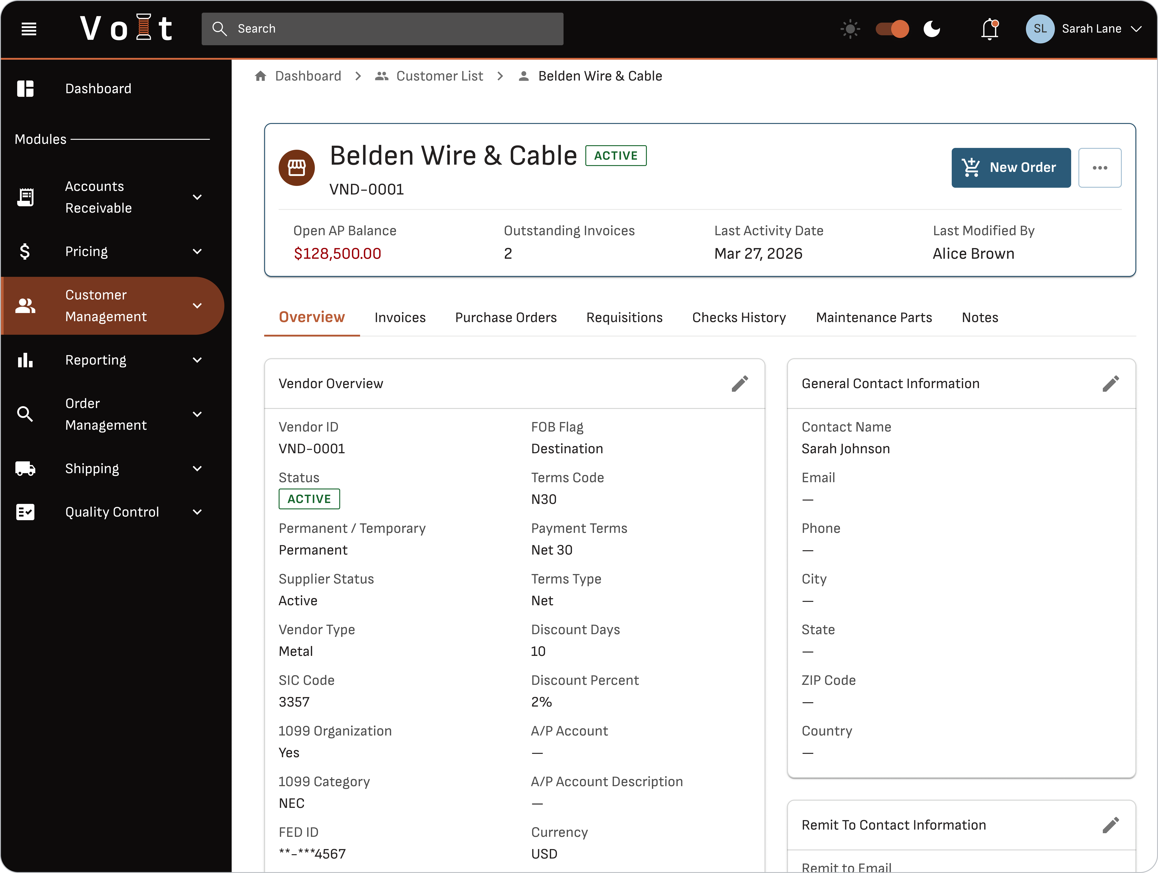
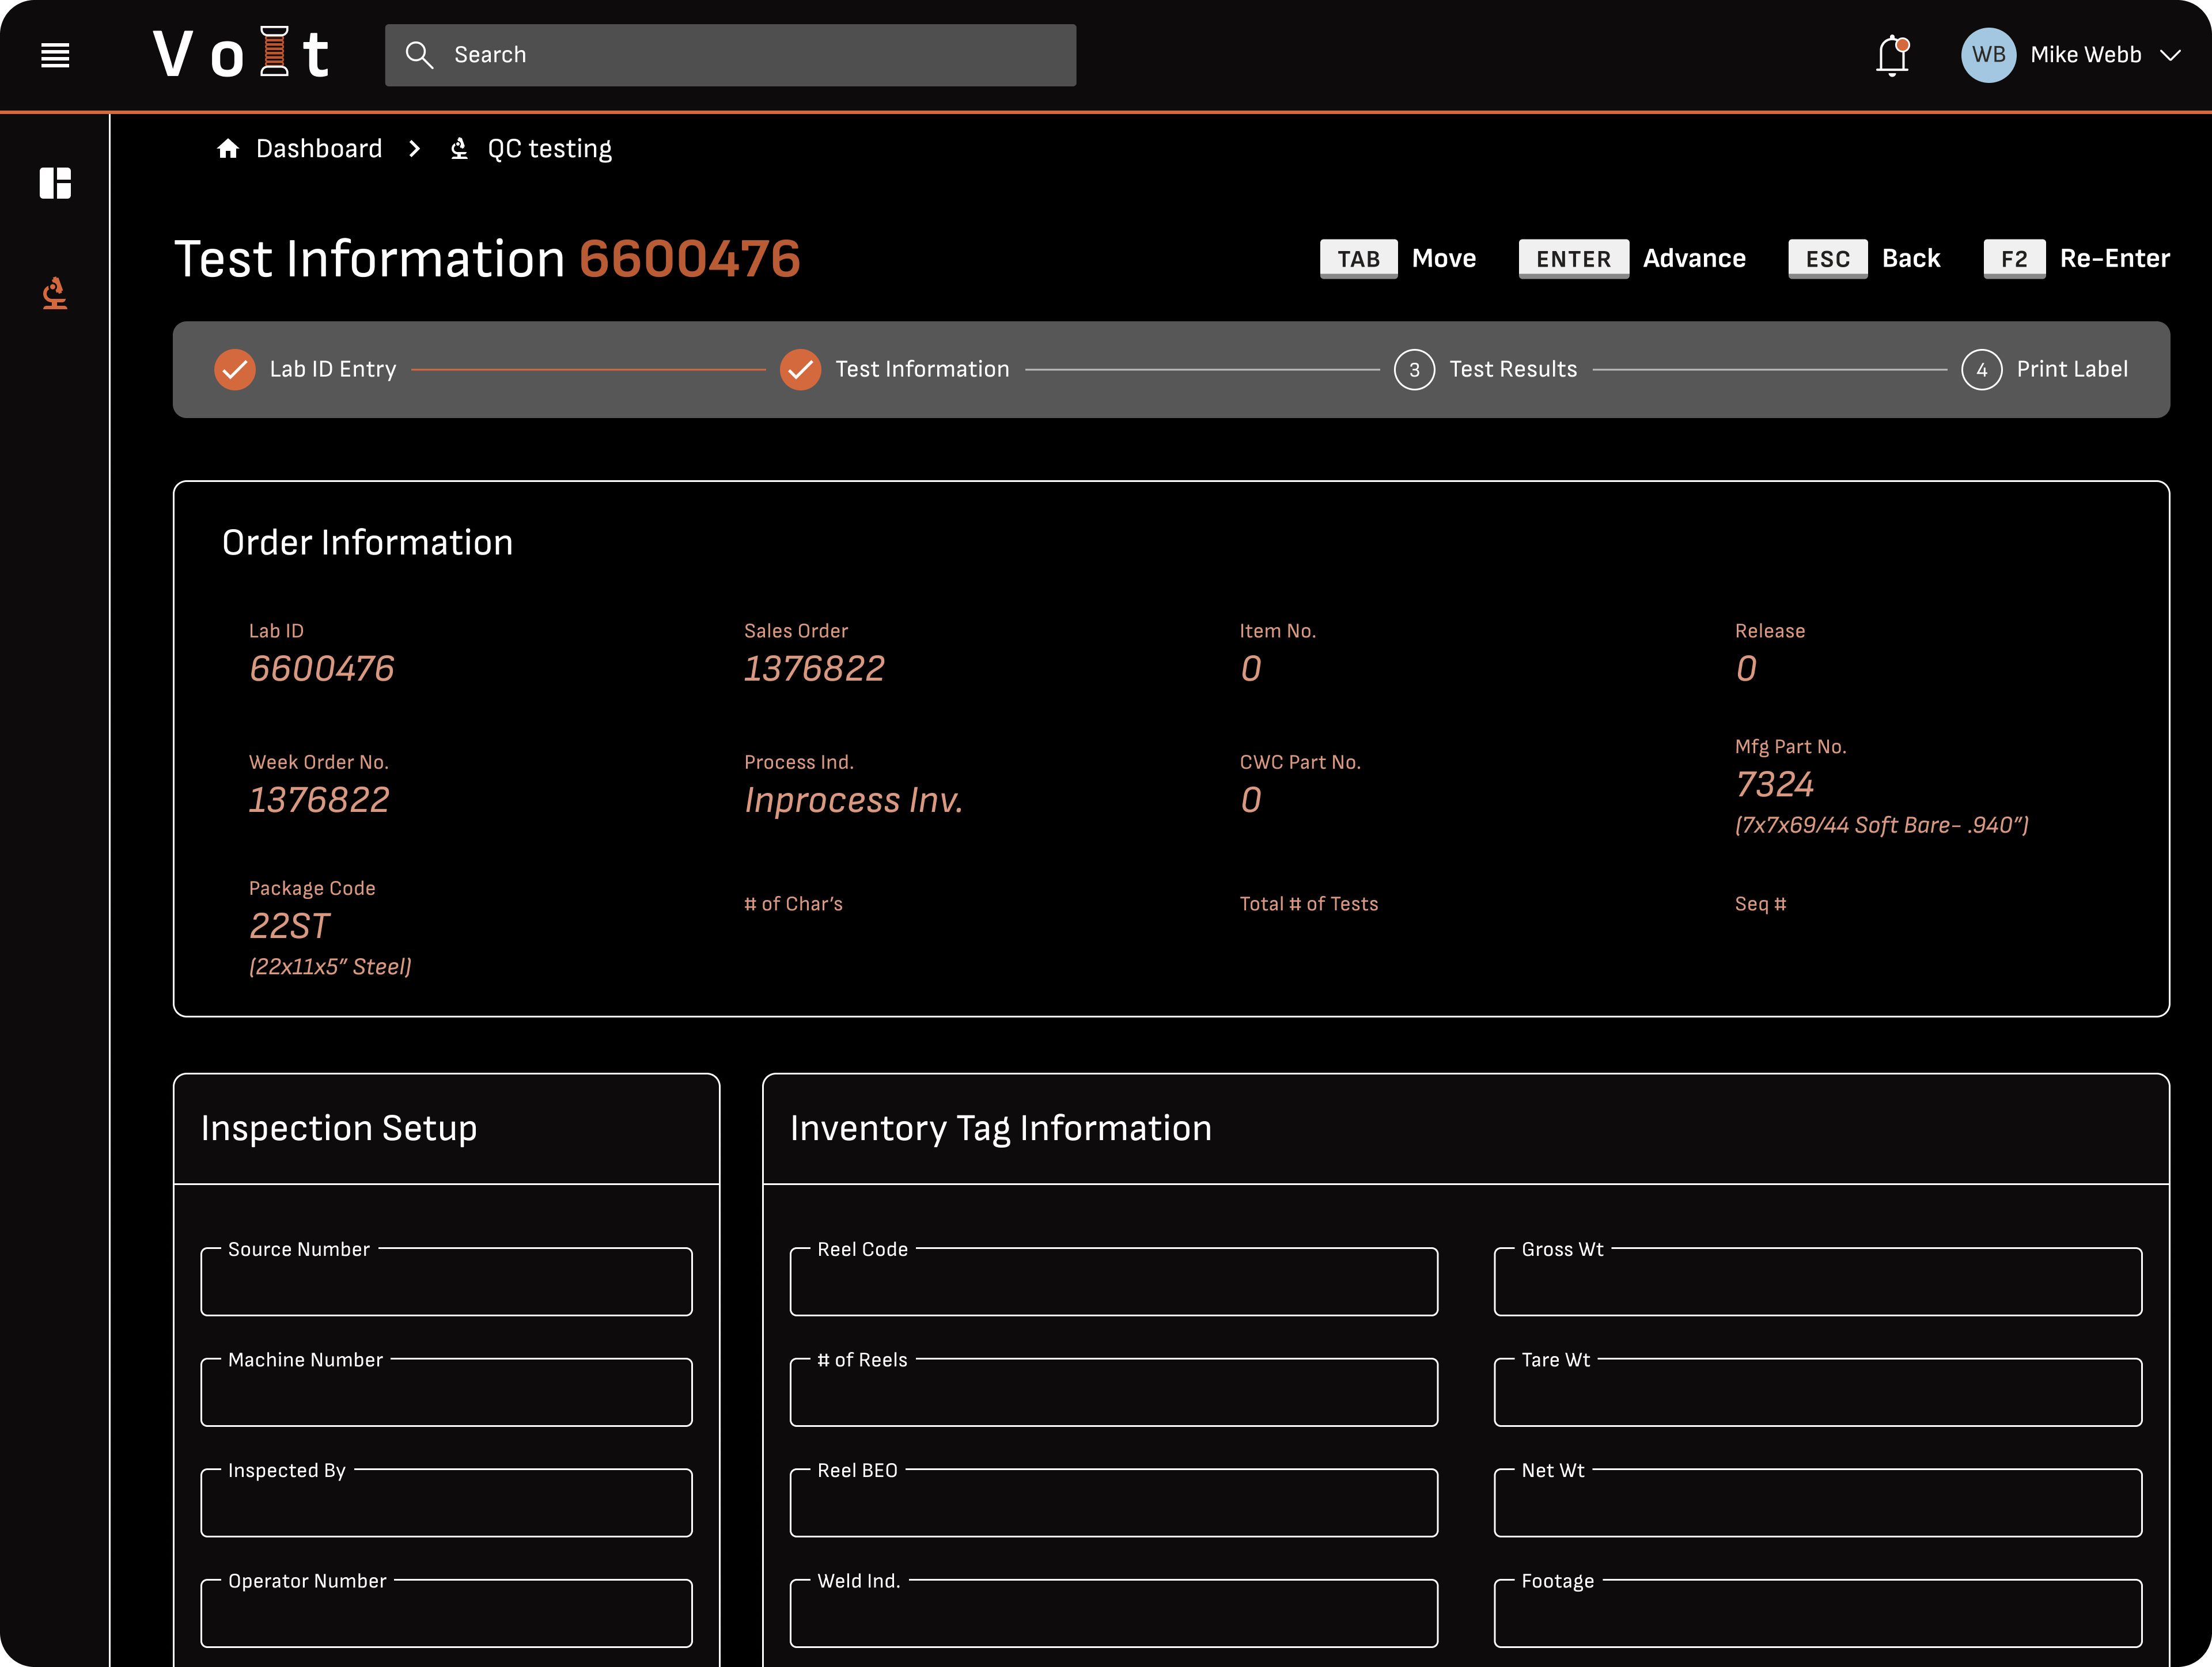
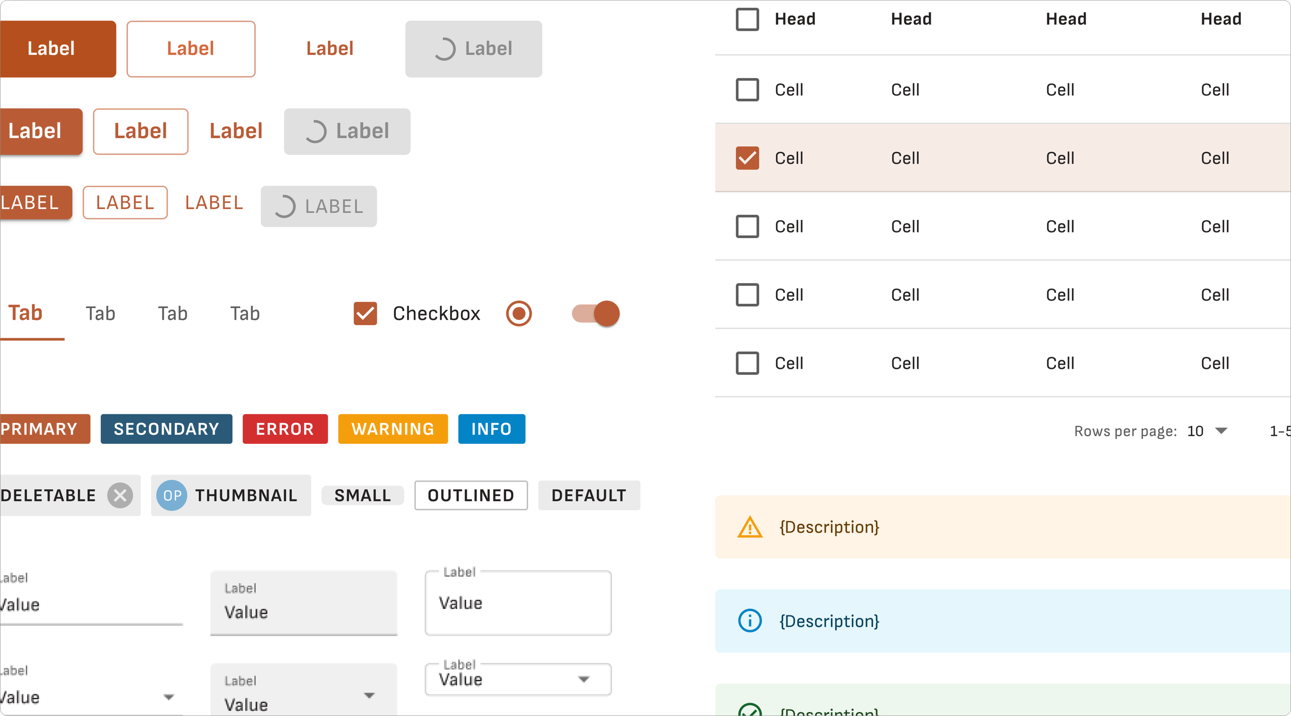
Designed the all-new Volt ERP experience, retiring decades of legacy mainframe operations
Case study
Pantheon Volt
International Wire Group, a copper wire manufacturer, relied on a decades-old VAX-based mainframe system across QC, customer management, AP documents, and scheduling, creating friction for factory floor and back-office teams alike. We designed Volt ERP, a modern MUI-based platform, establishing reusable patterns like split panels, drawer editing, and multi-step forms across each domain. The result is a scalable, documented design system and an AI-assisted design-to-dev workflow that keeps specs and engineering in sync as the platform grows.
400+
Screens estimated to complete the full ERP system
How We Helped
Established a comprehensive MUI component system with documented interaction rules
Rapidly tested edge cases and alternate scenarios in a working prototype rather than static documentation
Built an AI-assisted workflow, exporting Figma designs and using Claude to generate structured, reusable documentation for developer handoff
Replaced inconsistent manual handoff processes with a living documentation system that scales as new components are added
20+
Screens designed, establishing the reusable system
  1
Documented design system enabling that scale

Slide 31








West Monroe brings relevant EMS market exposure and proven capabilities to support complex, multi-site technology implementations
Our expertise
Status | Name
 | Not Started​ | WIP​ | Complete​ | QA’d​
 | ​Notes
 | ​
 | ​
RELEVANT SCOPE & CAPABILITIES
REPRESENTATIVE EXPERIENCE
Strategic PMO & Program Governance
Establish fit-for-purpose governance, decision rights, executive reporting, and program controls across scope, risk, issues, and dependencies
Multi-Site Implementation Management
Coordinate phased deployment plans, milestones, and readiness across operating units with differing processes and implementation needs
Vendor & Cross-Functional Coordination
Align business, technology, vendor, and third-party teams while actively managing interdependencies, risks, and issue resolution
Testing, Cutover & Go-Live Readiness
Govern testing, cutover, go-live, and stabilization activities to support a controlled deployment and smooth transition to operations
Process Optimization & Standardization
Align future-state workflows across locations, standardizing where practical while accommodating necessary local requirements
Organizational Change Management
Drive stakeholder alignment, communications, readiness, training, and adoption to support sustained ways of working
Update
Insert other services we have worked with before
In Scope
WM has capability to support if needed

Slide 32
Representative Bio’s

Slide 33

Status | Name
 | Not Started​ | WIP​ | Complete​ | QA’d​
 | ​Notes
 | ​
 | ​
Background
Tyler is a leader on West Monroe’s Healthcare M&A team, focusing on payer, provider and healthcare IT sectors. During his 10+ years at West Monroe, he’s supported 400+ transactions and has helped hundreds of private equity firms and portfolio companies assess, plan, and implement technology initiatives that advance growth objectives.
Tyler brings hands-on experience across multi-site, post-acute, and home-based services; revenue cycle and payment integrity; payer services and cost containment; EMR/PMS platforms; and value-based primary care models.
In 2025, he was named to M&A Advisors’ Emerging Leaders list and is a frequent source on healthcare M&A for CNBC, Axios, Modern Healthcare, and other leading outlets. Prior to joining WM, Tyler managed contact center operations and technology for a health system.
What makes Tyler different
A proud Indiana native, Tyler grew up during the heyday of Indiana college and pro basketball and enjoys catching a game when he can.
Where Tyler makes an impact
As a former healthcare operator, Tyler helps clients navigate complex and emerging industry dynamics to identify solutions that move the needle on cost, quality, and outcomes.
Industries served
  Payer & Provider Services
  Healthcare IT & Technology-Enabled Services
  Private Equity
Tyler Giesting
  Managing Director, Healthcare M&A
Skills & Specialties
  Sell-side diligence & exit planning
  Buy-side diligence & M&A integration
  Commercial & competitive diligence
  Value identification & roadmap execution; product strategy; vendor selection & implementation
  LSS & process improvement

Slide 34
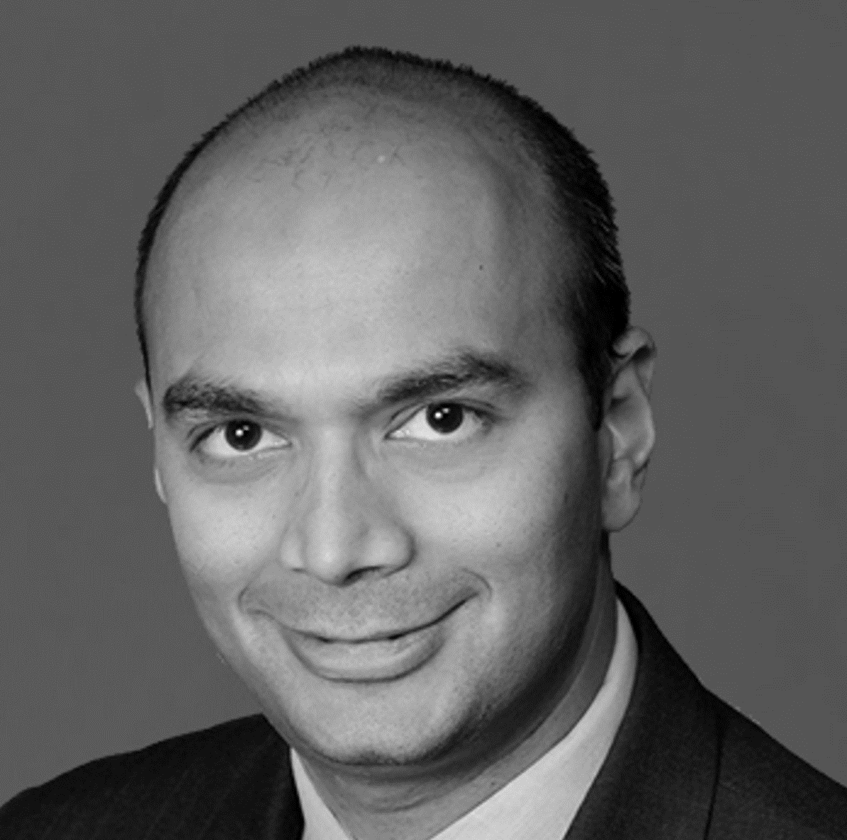
Status | Name
 | Not Started​ | WIP​ | Complete​ | QA’d​
 | ​Notes
 | ​
 | ​
Background
Leveraging decades of consulting experience, Dhaval specializes in helping software, technology, and IT services companies capitalize on emerging trends and drive growth. He has partnered with clients to create and grow new products, maximize value through M&A transactions, drive cross-functional initiatives, enable profitable growth through digital transformation, and transition to subscription-based business models. Dhaval energizes and aligns teams around growth opportunities and mentors junior consultants. Prior to joining West Monroe, he was a managing director at Waterstone Group. He holds degrees from Mumbai University and Indiana University.
  What makes Dhaval different
    A husband and father, Dhaval enjoys hiking, biking, and traveling. He has spent time in more than 25 countries and has lived and worked on three continents.
  Where Dhaval makes an impact
    Dhaval led the transformation of an enterprise software company’s operating model, tripling subscription revenue. He transformed a SaaS provider’s customer engagement model, increasing retention rates, and launched subscription offerings delivering over $200 million in value.
Industries served
  Private Equity
Dhaval Moogimane
  Senior Partner, High-Tech & Software
Skills & Specialties
  25+ Ops and Strategy engagements with enterprise software providers ​
  $1 B Information Mgt Provider: Post sales operating model transformation​
  $1.4B Workforce Mgmt. Software: SaaS Transformation​
  $700M Higher Ed Software: Cloud offering launch and scale​

Slide 35

Status | Name
 | Not Started​ | WIP​ | Complete​ | QA’d​
 | ​Notes
 | ​
 | ​
Background
Erik is a seasoned software engineer, entrepreneur, and leader who leverages innovative technology to drive business value. He led a $20 million technology roadmap project, enhancing a client’s risk modeling and cutting technology costs by over $10 million annually. As the executive technical lead for West Monroe’s AI Lab, he spearheaded the rollout of an internal AI chat platform and client-facing AI accelerators. Erik frequently speaks at industry events and hosts West Monroe’s “This is Digital” podcast. With extensive experience in software engineering, cloud computing, and AI, he leads the engineering team in PXEL practice. Erik holds a bachelor’s degree from the University
of Illinois.
  What makes Erik different
Erik lives in Chicago with his family, enjoys music, and blends artistic expression with math and science through piano.
  Where Erik makes an impact
Erik volunteers at St. Francis Xavier School, leading the Technology Committee; West Monroe designs their annual report.
Industries served
  Healthcare
  Private Equity
  Capital Markets
Erik Brown
  Senior
  Partner, Product
  Experience and Engineering Lab
Skills & Specialties
  Machine Learning / Artificial Intelligence​
  Amazon Web Services​
  Microsoft Windows Azure​
  Enterprise messaging and distributed architecture​
  Java/JEE, Microsoft .NET & Python

Slide 36

Status | Name
 | Not Started​ | WIP​ | Complete​ | QA’d​
 | ​Notes
 | ​
 | ​
Background
To fill in
  What makes Ri different
To fill in
  Where Erik makes an impact
To fill in
Industries served
  Healthcare
  Private Equity
  Financial Services
  Technology & Software
Ri Scott
  Managing Partner
  Product Engineering & Software Modernization
Skills & Specialties
  Artificial Intelligence​
  Software Modernization
  AI-Native Product Development Lifecycle
  Microsoft .NET, Go, Python, TypeScript, Web Application Development

Slide 37
Eaglesoft will eliminate critical business continuity concerns, preserve critical features, drive differentiation, and unlock future optionality for the enterprise.
Scalable, secure & maintainable enterprise architecture
Status | RI
 | Not Started​ | WIP​ | Complete​ | QA’d​
 | ​Notes
 | ​
 | ​
Responsive UI
optimized for desktop users and capable of rendering on tablet and mobile devices
KEY FEATURE
FRONT END
React.js
Update
Phase Zero mobilization and baseline - First 30 days to validate the estate, existing performance suite, environments, datasets, priorities, telemetry, and acceptance measures.
  RESULTS YOU CAN COUNT ON
  Functional parity with the VAX
  Improved SOX readiness through:
    Clear data lineage
    Modern controls
    Documented architecture
  Platform extensibility:
    Multi-entity support
    Future acquisitions
  Reduced dependency on tribal knowledge
KEY FEATURE
Single language (JavaScript) for Front and Back End development
BACK END
Node.js
DATABASE
Azure SQL
Scalable integration framework for future expansions
REPORTING
PowerBI
KEY FEATURE
KEY FEATURE
INTEGRATIONS
Salesforce
Modernized reporting
and analytics
ENVIRONMENT SETUP
DEV
QA
TEST
PROD
Notes:
Our Differentiators:
- Easier technology due diligence in future transactions
- Improved SOX readiness through:
Clear data lineage
Modern controls
Documented architecture
- Platform extensibility:
Multi-entity support
Future acquisitions
- Reduced dependency on tribal knowledge

Slide 38
Working with your team (and our AI-tools and your source code), we’ve already identified the functional and non-functional backlog that must be delivered.
Scalable, secure & maintainable enterprise architecture
Status | Ri
 | Not Started​ | WIP​ | Complete​ | QA’d​
 | ​Notes
 | ​
 | ​
545 Total Functional Features
  Fairly evenly split between WM (250) and Pantheon (235) contributions
  (not MECE)
  Jointly identified scope: 51
  Broken up into 232 Epics
54 Non-functional Requirements
All requirements are broken divided into 20 Business Capability Domains
Update
Modernization Factory- How priority workflows move from inventory through domain design, conversion, testing, parallel operation, rollout, and handoff. Including AI as an execution accelerator for analysis and coding.
Milestones could include: inventory, prioritize, prove, migrate, scale
Customer Management
Order Management
Pricing
Complaint Tracking
Purchasing
Inventory
Warehouse
Toll Customer
Scheduling
QC Testing
MOTARS
Engineering
AP
AR
GL
Payroll
Reporting
Security & Access Control
Error Handling & Exceptions
System Administration & Monitoring

Slide 39
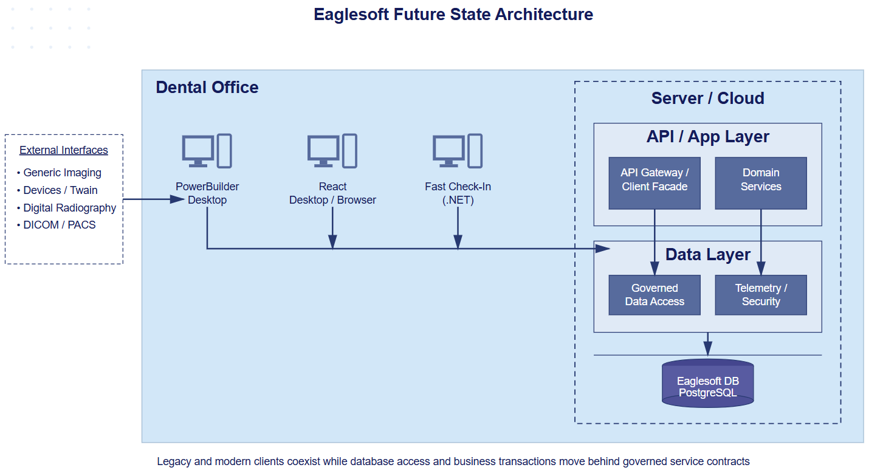
We’ll design and co-develop a scalable, flexible solution that will help enable Eaglesoft to transition from a database-coupled PowerBuilder architecture to a governed service and domain architecture that supports modernization and future browser-based deployment..
Scalable, secure & maintainable enterprise architecture
Status | Drew / Jim
 | Not Started​ | WIP​ | Complete​ | QA’d​
 | ​Notes
 | ​
 | ​
Conceptual Future State Architecture
Update
Reusable Data and API Foundation- Explain that the architecture is intended to be reused across PowerBuilder and desktop workflows, browser experiences, and SaaS products. Creates foundation for Saas Journey
We’ll work hand-in-hand with you to design a future-state architecture that:
Removes direct database access from PowerBuilder
Introduces a stable service/API boundary
Establishes a domain-oriented application layer
Centralizes and governs PostgreSQL data access
Among other changes to enable future scalability and security

